Slide 1
Basic Computing Curriculum
Session 3: Internet Navigation
Notes:
Welcome to Session 3 of our course. In this presentation, we will cover the basics of Internet Navigation, including what is the internet, web browsers, searching for information online, and internet security and privacy.

Slide 2

Presentation Overview
Introduction to the Internet and its history
Online security and privacy
Web browsers and search engines
Effective search techniques and evaluating sources
Recognizing secure websites and common scams
Practical activity and further practices
Notes:
This presentation covers the basics of computing, with a focus on the Internet, online security and privacy, web browsers and search engines, effective search techniques and evaluating sources, recognizing secure websites and common scams, and practical activities and further practices. By the end of the presentation, you should have a strong understanding of how to use the Internet safely and efficiently.

Slide 3

Introduction: What is the Internet?
The Internet is a global computer network that connects people and information.
The Internet has its roots in the United States military's ARPANET project.
The Internet has revolutionized communication, commerce, and many other aspects of modern life.
Notes:
The Internet is a vast and complex network of computers and servers that spans the globe, connecting people and information like never before. The origins of the Internet can be traced back to the United States military's ARPANET project in the 1960s. Since then, the Internet has grown and evolved, becoming an essential tool for communication, commerce, and much more. In this slide, we will explore the basics of what the Internet is and how it works.

Slide 4

Precautions on the Internet
Avoid clicking on links from unknown or suspicious sources to avoid computer viruses.
Understanding common scams can help you avoid falling victim to them online.
Protecting your personal information online is crucial for avoiding identity theft and other forms of cybercrime.
Notes:
The internet can be a dangerous place, but there are steps you can take to protect yourself. One of the most important things to remember is to avoid clicking on links from unknown or suspicious sources. Doing so can often lead to computer viruses or other forms of malware. Additionally, it is important to understand common scams, such as phishing, and how to avoid falling victim to them. Finally, protecting your personal information online is crucial for avoiding identity theft and other forms of cybercrime.

Slide 5

Web Browsers
Web browsers are software applications that allow users to access the World Wide Web.
Most web browsers support multiple tabs and windows, allowing users to navigate multiple web pages at once.
Web browsers use HyperText Transfer Protocol (HTTP) to communicate with web servers and retrieve web pages.
Notes:
Web browsers are an essential tool for accessing the internet and navigating the World Wide Web. They allow users to access a variety of web pages and services with ease. Modern web browsers also offer a range of features, such as add-ons and extensions, that can enhance the browsing experience. Additionally, web browsers play an important role in cybersecurity by providing secure connections to websites that handle sensitive information, such as online banking sites.

Slide 6

Search Engines
A search engine is a software program that searches a database of Internet sites to find the information you request.
Search engines use algorithms to prioritize search results based on relevance to the search terms.
Google is the most popular search engine, but other search engines like Bing and Yahoo also exist.
Notes:
Search engines are an essential tool for navigating the vast amount of information available on the Internet. They use complex algorithms to search through a database of websites and provide users with relevant results. Google is the most popular search engine, but other options like Bing and Yahoo also exist. Understanding how to use search engines effectively is an important skill for finding information online.

Slide 7

Effective Search Techniques
Using specific keywords and phrases in your search can help you find more relevant results.
Filters can help narrow down search results by date, location, and other factors.
Examples of search techniques include using quotation marks to search for phrases and using the minus sign to exclude certain words.
Notes:
When searching the internet, it's important to use effective search techniques to find the information you need. Using specific keywords and phrases, as well as filters, can help you find more relevant results. For example, using quotation marks around a phrase will search for that exact phrase, and using the minus sign before a word will exclude it from your search results. By using these techniques, you can quickly and easily find the information you need.

Slide 8

Evaluating Sources in Google Search
It's important to evaluate the credibility of sources found in Google search results.
Reliable sources are those that demonstrate expertise in the subject matter, while unreliable sources lack credibility.
Ways to evaluate sources include checking the author's credentials, looking for bias, and verifying information with corroborating sources.
Notes:
With so much information available on the internet, it's important to be able to evaluate the credibility of sources. This is especially true when using Google search to find information. During this slide, we will discuss how to distinguish between reliable and unreliable sources, and how to evaluate the credibility of sources found in Google search results. We will cover what to look for in an author's credentials, how to spot bias, and the importance of verifying information with corroborating sources.

Slide 9
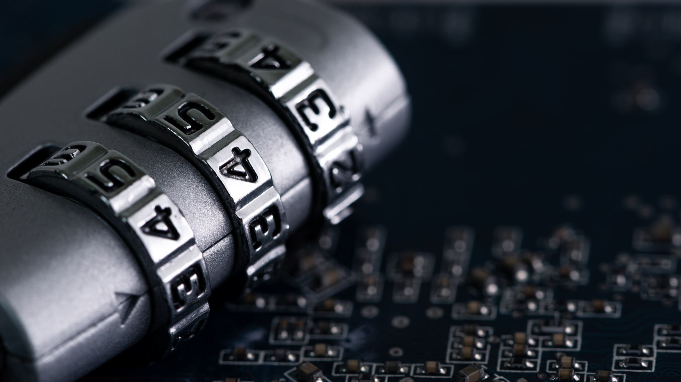
Internet Security Basics
Online security is more important than ever as hackers become increasingly sophisticated.
A strong password is crucial to protecting your online accounts from unauthorized access.
A password manager can help you generate and store complex passwords securely.
Notes:
In today's digital age, it's more important than ever to be vigilant about online security. One of the most important things you can do to protect yourself is to create a strong password. This means using a combination of letters, numbers, and symbols, and avoiding easily guessable passwords like 'password' or '123456'. Additionally, using a password manager can help you generate complex passwords and store them securely, reducing the risk of a security breach.

Slide 10
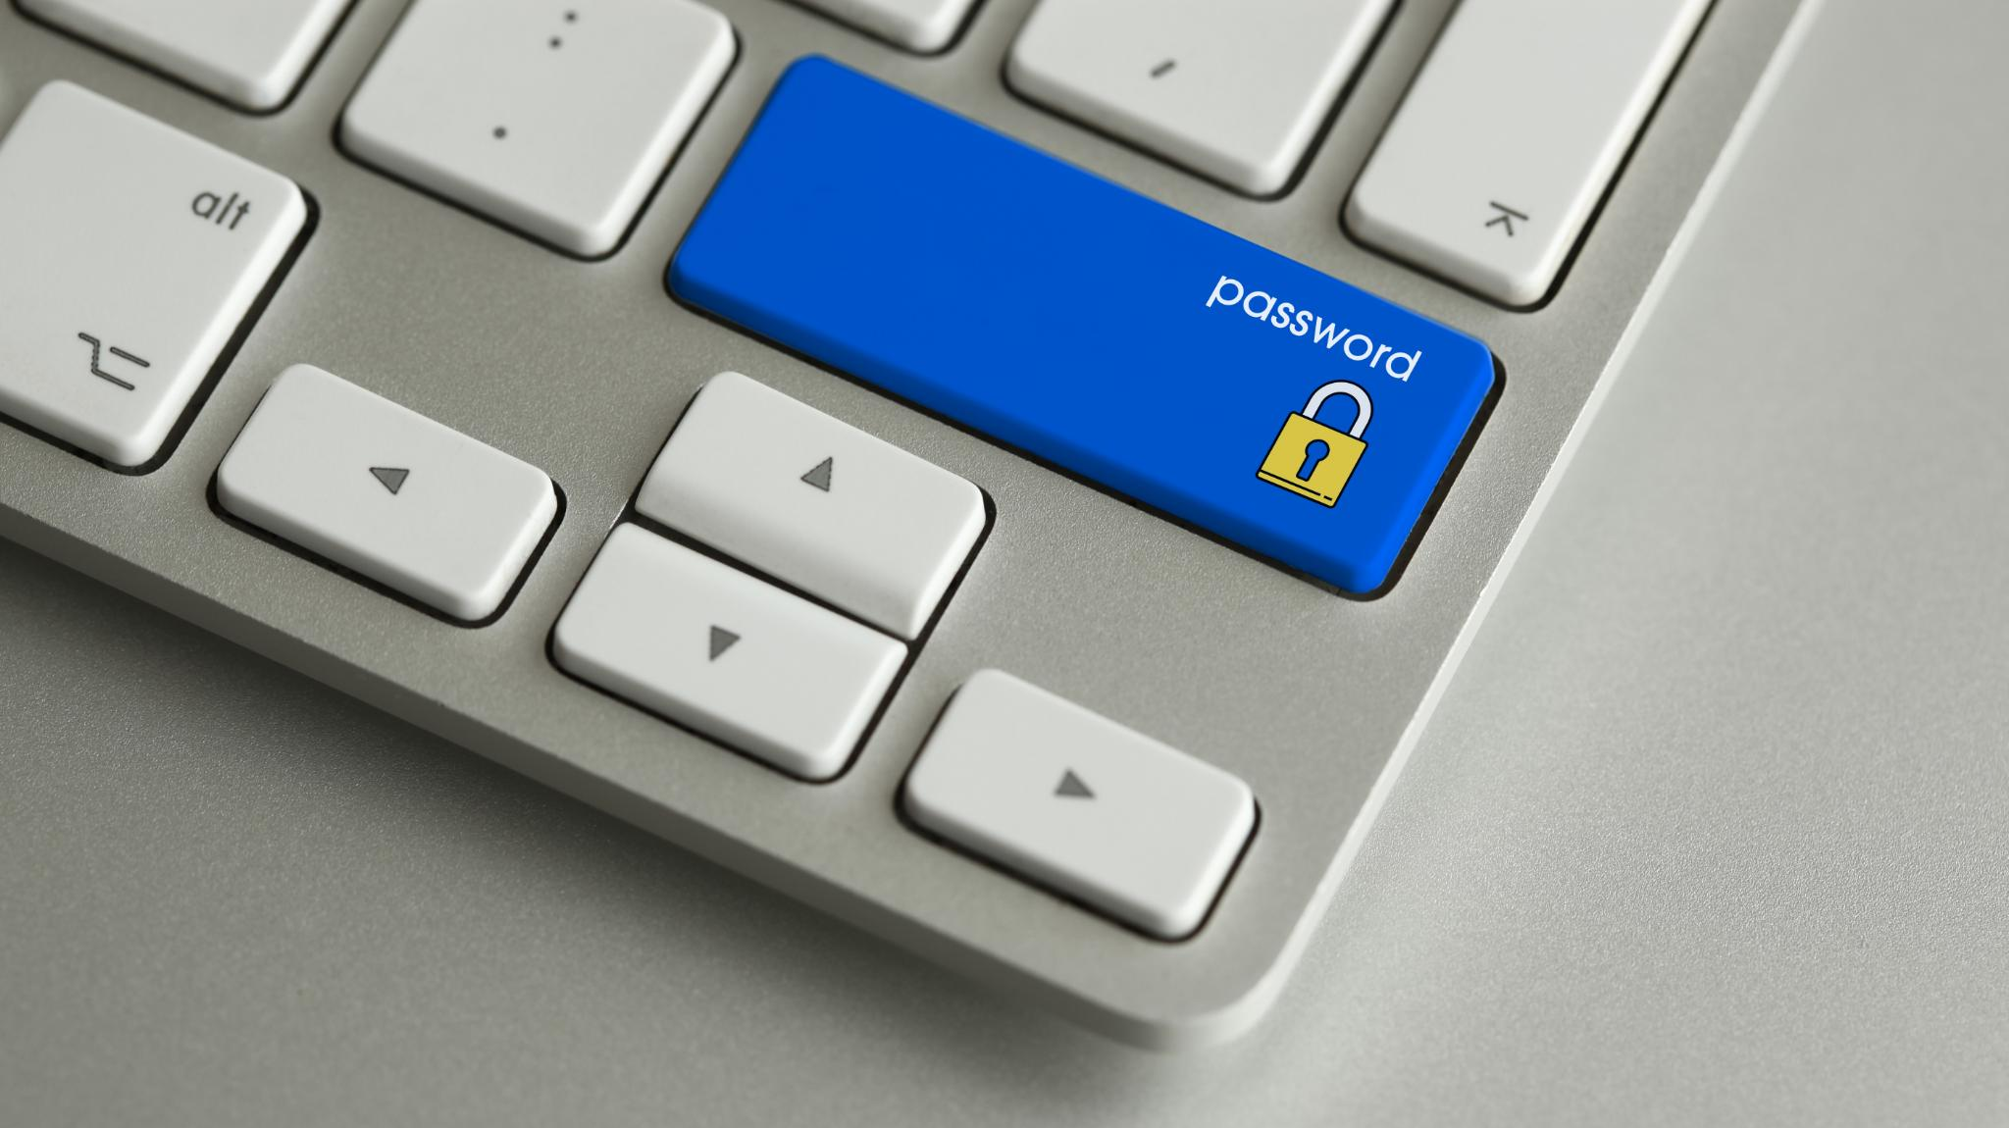
Privacy Settings and Social Media Privacy
Adjusting your browser settings can help protect your privacy online.
Be aware of the privacy settings on your social media accounts.
Consider limiting the amount of personal information you share online.
Notes:
In a world where so much personal information is shared online, it's important to take steps to protect your privacy. One of the easiest ways to do this is by adjusting the settings on your web browser. Additionally, you should always be aware of the privacy settings on your social media accounts and limit the amount of personal information you share online. By taking these steps, you can help keep your personal information safe and secure.

Slide 11

Recognizing Secure Websites
Secure websites use HTTPS protocol to encrypt data between the website and the user's browser.
Browsers display a padlock icon in the address bar for secure websites.
Secure websites have a valid security certificate validated by a trusted Certificate Authority (CA).
Notes:
Secure websites are becoming increasingly important to protect sensitive information online. One way to recognize a secure website is to look for the HTTPS protocol in the website address, which means that data is encrypted between the website and the user's browser. Browsers also display a padlock icon in the address bar to indicate a secure website. Finally, secure websites have a valid security certificate, which is verified by a trusted Certificate Authority (CA).

Slide 12
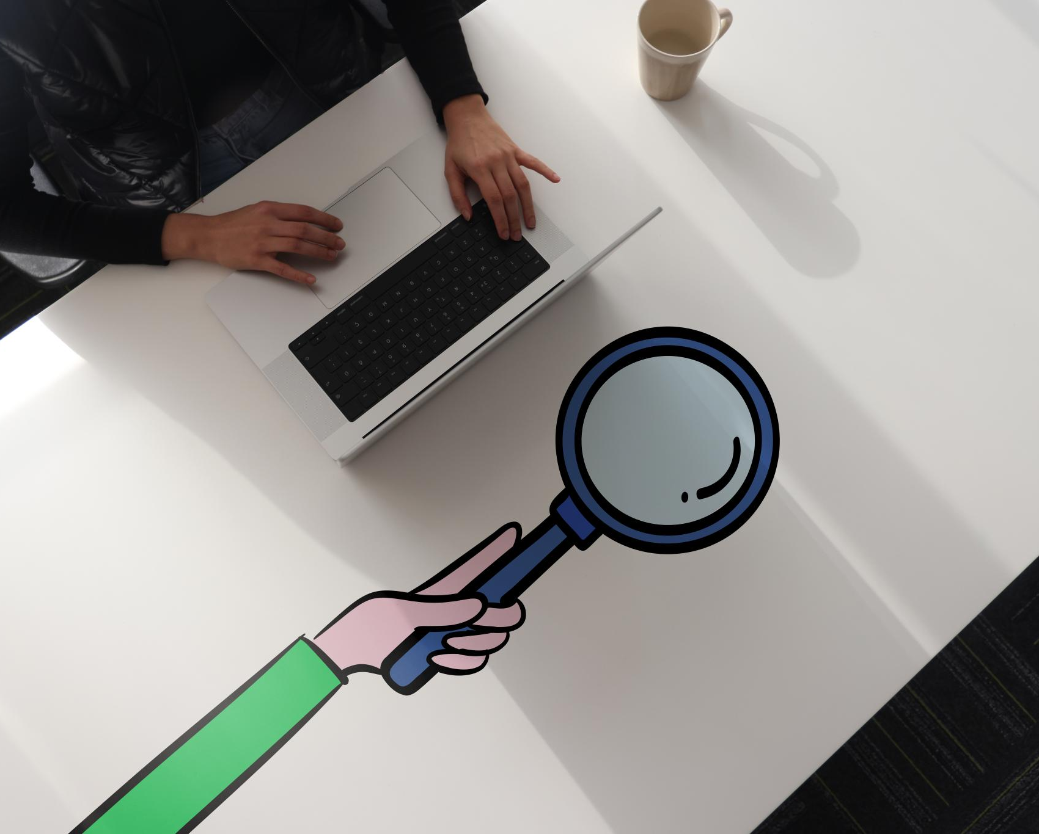
Practical Activity
Perform a Google Search:
  Open your web browser and go to www.google.com.
  In the search bar, type “weather today” and press Enter.
  Look at the results and click on a link to check the weather in your area.
Visit a Secure Website:
  In the browser, type in “www.wikipedia.org” and press Enter.
  Notice the padlock icon next to the web address. This shows the site is secure.
  Navigate to a page of interest, like searching for “Albert Einstein” on Wikipedia.
Practice Safe Browsing:
  Try searching for something else of interest, like “healthy recipes” or “local news.”
  Before clicking a link, check to see if it’s a reputable website.

Slide 13

Conclusions
The internet is a global network that connects people and information.
Web browsers and search engines are tools that allow us to access the internet and find information.
Online security and privacy are crucial for protecting ourselves from cybercrime.

